Slide 1


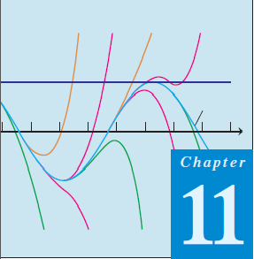
Thomas Calculus 11th
12
Infinite Series
Samuel Lukas

Slide 2
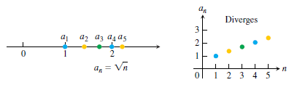






Infinite Sequence Definition
An infinite sequence of numbers is a function whose domain is the set of positive integers.
Examples :
$$a_{n}=f\left(n\right)=2n$$
$$2,4,6,8,…,2n,…$$
$$a_{n}=f\left(n\right)=10+2n$$
$$12,14,16,18,…,10+2n,…$$
$${\{a}_{n}\}=\{\sqrt{1},\sqrt{2},\sqrt{3},…,\sqrt{n},…$$

Slide 3
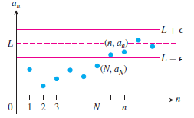
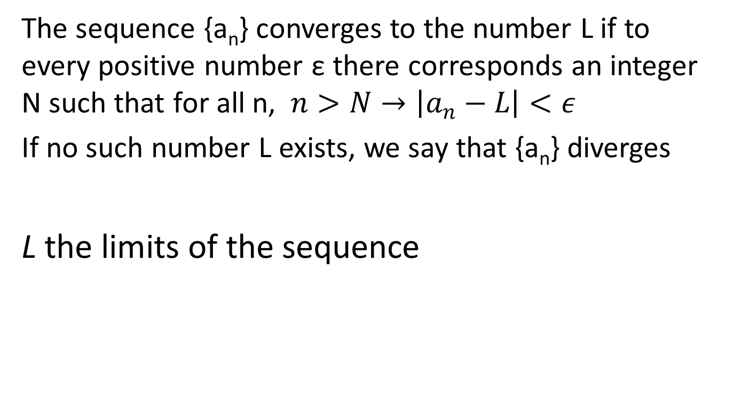

Converges, Diverges, Limit
The sequence {a_{n}} converges to the number L if to every positive number ε there corresponds an integer N such that for all n, $n>N→\left|a_{n}−L\right|<ε$
If no such number L exists, we say that {a_{n}} diverges
L the limits of the sequence
$$\lim_{n→∞}{a_{n}=L{}_{}or{}_{}a_{n}}→L,$$

Slide 4








Exercises 01
Find the values of a₁, a_{2,} a_{3,} a₄ of these sequence :
Write out the first 10 terms of these recursion sequence :
Find a formula for the n^{th} term of the sequence :

Slide 5

























Exercises 02
Which of these sequences are converge and which are diverge !

Slide 6
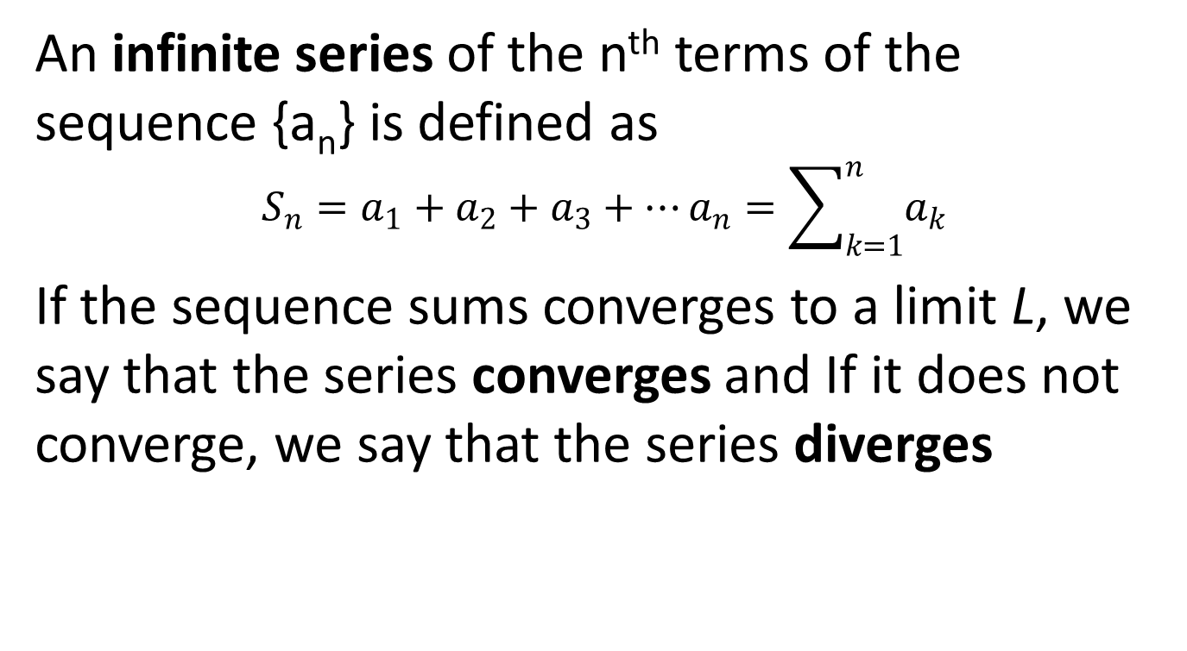
Infinite Series Definition
An infinite series of the n^{th} terms of the sequence {a_{n}} is defined as
$$S_{n}=a_{1}+a_{2}+a_{3}+…a_{n}=\sum_{k=1}^{n}{a_{k}}$$
If the sequence sums converges to a limit L, we say that the series converges and If it does not converge, we say that the series diverges

Slide 7
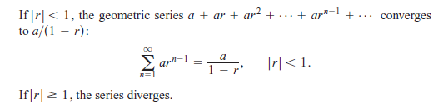



Geometric Series
Examples :

Slide 8

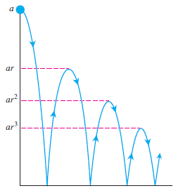

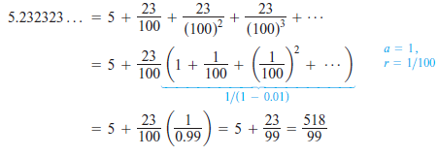
Examples 01

Slide 9

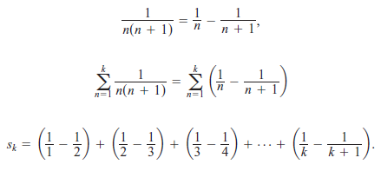


Examples 02

Slide 10
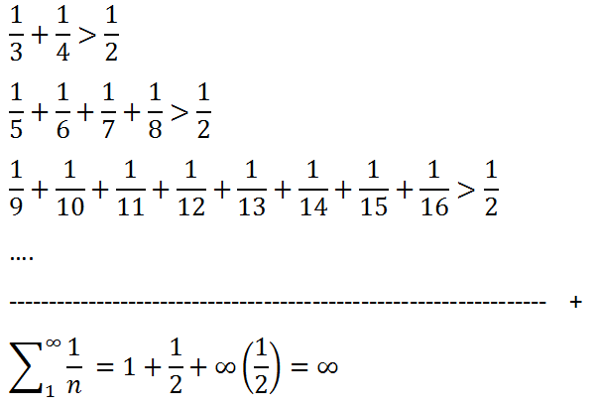

Examples 03
Determine the series of $\sum_{1}^{∞}{\frac{1}{n} }$
Diverges

Slide 11
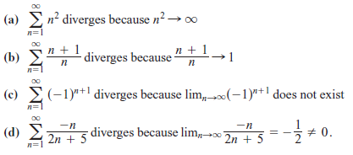
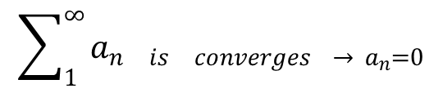
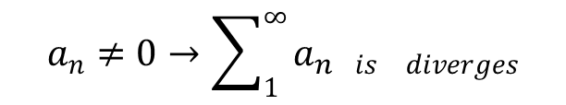
Basic Rules
$$\sum_{1}^{∞}{a_{n_{} is_{} converges → a_{n}=0}}$$
$$a_{n}≠0→\sum_{1}^{∞}{a_{n_{}is_{} diverges}}$$
Examples :

Slide 12
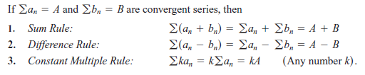
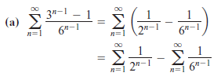



Basic Rules
Examples :

Slide 13

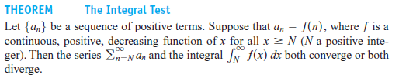
Integral Test

Slide 14
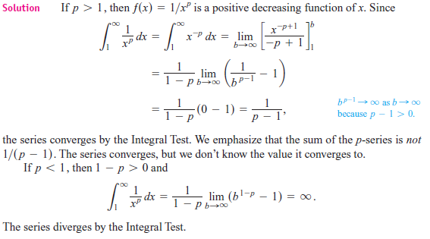
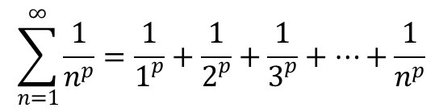
Example 04
Show that the p-series, with p a real constant converges if p > 1, and diverges if p < 1
$$\sum_{n=1}^{∞}{\frac{1}{n^{p}}=\frac{1}{1^{p}}+\frac{1}{2^{p}}+\frac{1}{3^{p}}+…+\frac{1}{n^{p}}}$$

Slide 15
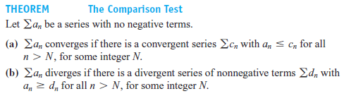
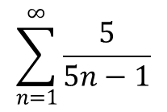
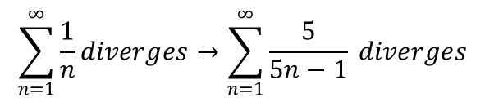
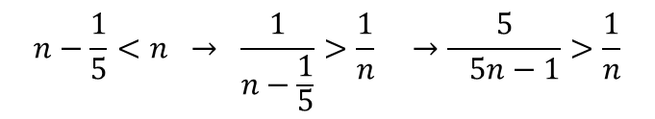
Comparison Test
Examples :
$$\sum_{n=1}^{∞}{\frac{5}{5n−1}}$$
Converges or diverges ?
$$n−\frac{1}{5}<n → \frac{1}{n−\frac{1}{5}}>\frac{1}{n} →\frac{5}{ 5n−1}>\frac{1}{n}$$
$$\sum_{n=1}^{∞}{\frac{1}{n}diverges→\sum_{n=1}^{∞}{\frac{5}{5n−1} diverges}}$$

Slide 16
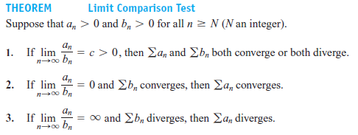
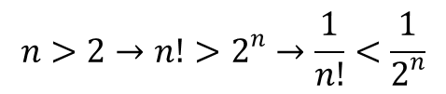
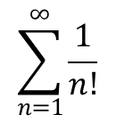
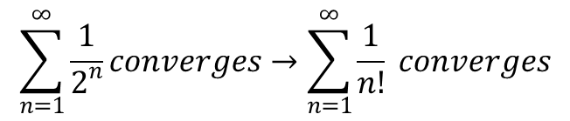
Limit Comparison Test
Examples :
$$\sum_{n=1}^{∞}{\frac{1}{n!}}$$
Converges or diverges ?
$$n>2→n!>2^{n}→\frac{1}{n!}<\frac{1}{2^{n}}$$
$$\sum_{n=1}^{∞}{\frac{1}{2^{n}}converges→\sum_{n=1}^{∞}{\frac{1}{n!} converges}}$$
and

Slide 17
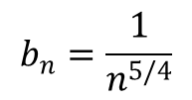
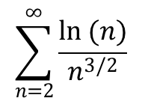
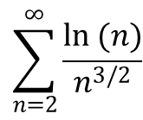
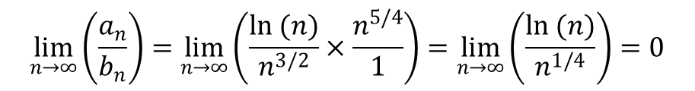
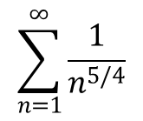
Example 5
Examples :
$$\sum_{n=2}^{∞}{\frac{ln (n)}{n^{3/2}}}$$
Converges or diverges ?
$$b_{n}=\frac{1}{n^{5/4}}$$
$$\sum_{n=1}^{∞}{\frac{1}{n^{5/4}}}$$
and
Converges
$$\lim_{n→∞}\left(\frac{a_{n}}{b_{n}}\right)=\lim_{n→∞}\left(\frac{ln (n)}{n^{3/2}}×\frac{n^{5/4}}{1}\right)=\lim_{n→∞}\left(\frac{ln (n)}{n^{1/4}}\right)=0$$
$$\sum_{n=2}^{∞}{\frac{ln (n)}{n^{3/2}}}$$
Then
Converges

Slide 18
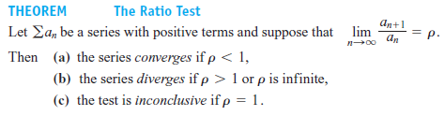
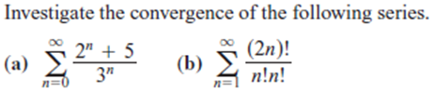


Ratio Test
Examples :

Slide 19
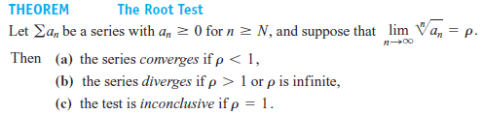

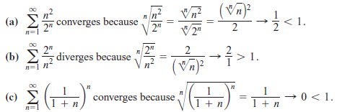
Root Test
Examples :

Slide 20
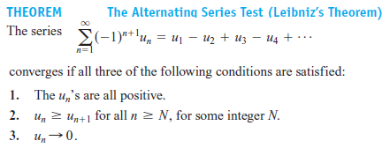


Alternating Series
Examples :

Slide 21
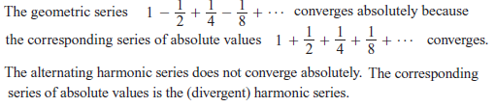

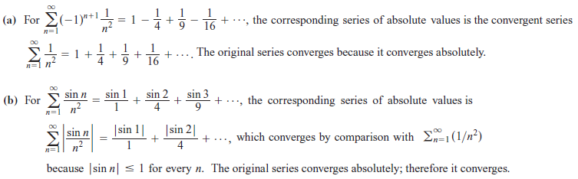
Absolute and Conditional Convergent

Slide 22
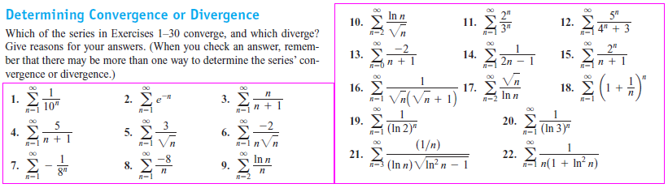





Exercises 03

Slide 23
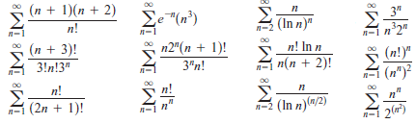
Exercises 04
Which of these sequences are converge and which are diverge !

Slide 24
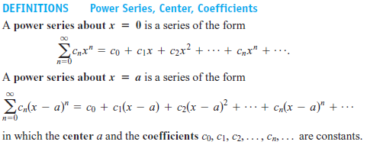


Power Series
Example :

Slide 25

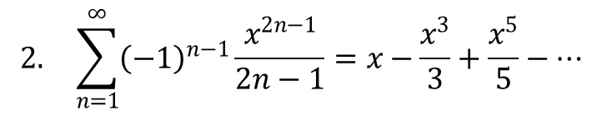
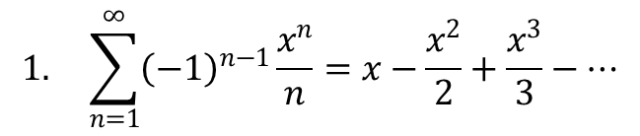
Testing for Convergence
$$1. \sum_{n=1}^{∞}{{\left(−1\right)}^{n−1}}\frac{x^{n}}{n}=x−\frac{x^{2}}{2}+\frac{x^{3}}{3}−…$$
$$ρ={\lim_{n→∞}\left|\frac{a_{n+1}}{a_{n}}\right|=\lim_{n→∞}\left|\frac{x^{n+1}}{(n+1)}×\frac{n}{x^{n}}\right|=\lim_{n→∞}{\frac{n}{n+1}\left|x\right|=\left|x\right|}}$$
In order to convergent then
$$ρ=\left|x\right|<1$$
Then Series converges for
$$\left|x\right|<{1}$$
At x = -1, we get -1 -1/2 -1/3 -1/4 - … the negative of the harmonic series, it diverges. At x = 1 the series converges then the series converges for $−1<x≤1$
$$2. \sum_{n=1}^{∞}{{\left(−1\right)}^{n−1}}\frac{x^{2n−1}}{2n−1}=x−\frac{x^{3}}{3}+\frac{x^{5}}{5}−…$$
$$ρ=\lim_{n→∞}\left|\frac{a_{n+1}}{a_{n}}\right|=\lim_{n→∞}\left|\frac{{\left(−1\right)}^{n}x^{2n+1}}{2n+1}×\frac{2n−1}{{\left(−1\right)}^{n−1}x^{2n−1}}\right|=\left|x^{2}\right|=x^{2}$$
Further check then The series converges for $x2≤1$

Slide 26
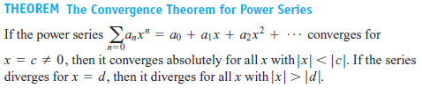
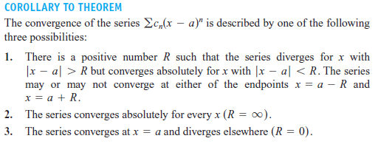
Theorems

Slide 27
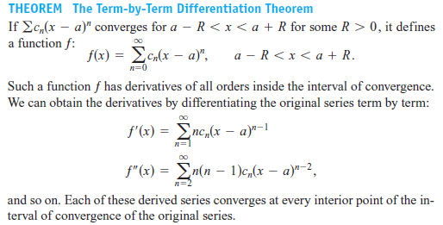
Theorems

Slide 28

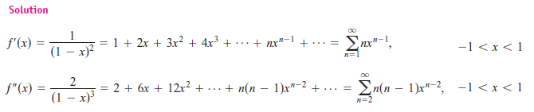
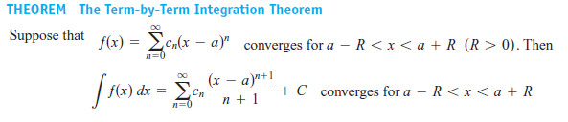
Theorems

Slide 29
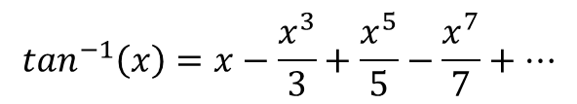



Examples 06
Find the series of tan⁻¹(x) and find the x so that the series converges
$We know that f\left(x\right)=\frac{1}{1−x}=1+x+x^{2}+x^{3}+x^{4}+…$ converges for - $1$< $x$ < $1$
Then $f\left(x\right)=\frac{1}{1−(−x^{2})}=\frac{1}{1+x^{2}}=1−x^{2}+x^{4}−x^{6}+…\text{converges} for −1<x<1$
Integral the f(x) then $\int{f(x)}dx=\int{\frac{dx}{1+x^{2}}=\tan^{−1}\left(x\right)+C}$
$$\text{W}\text{e} \text{know} \text{that} \int{\frac{dx}{1+x^{2}}=x−\frac{x^{3}}{3}+\frac{x^{5}}{5}}−\frac{x^{7}}{7}+…\text{converges} for −1<x<1$$
$$\tan^{−1}\left(x\right)=x−\frac{x^{3}}{3}+\frac{x^{5}}{5}−\frac{x^{7}}{7}+…$$
x = 0 → $\int{\frac{dx}{1+x^{2}}=\tan^{−1}\left(0\right)+C}=0 →c=0$
$${Further check then tan}^{−1}\left(x\right)=x−\frac{x^{3}}{3}+\frac{x^{5}}{5}−\frac{x^{7}}{7}+…\text{converges} for −1≤x≤1$$

Slide 30




Theorems
Example : $\frac{1}{\left(1−x\right)2}$ = …
$$A\left(x\right)=\sum{a_{n}}x^{n}=1+{x+x}^{2}+x^{3}+x^{4}+…=\frac{1}{1−x}$$
$$B\left(x\right)=\sum{b_{n}}x^{n}=1+{x+x}^{2}+x^{3}+x^{4}+…=\frac{1}{1−x}$$
$$c_{n}=a_{0}b_{n}+a_{1}b_{n−1}+a_{2}b_{n−2}+…+a_{n−1}b_{1}+a_{n}b_{0}=\sum{a_{k}b_{n−k}=1+1+…+1=n+1}$$
$$\sum{c_{n}}x^{n}=\sum{a_{n}x^{n}}×\sum{b_{n}x^{n}}=\sum{\left(n+1\right)x^{n}=1+2x+3x^{2}+…+(n+1)x^{n}}$$
$∴\frac{1}{{(1−x)}^{2}}=1+2x+3x^{2}+…+(n+1)x^{n}$ converges for -1< x <1

Slide 31

Tailor and Maclaurin Series
Example :
$$∴f\left(x\right)=\frac{1}{x}=\sum{\frac{f^{k}\left(2\right)}{k!}}{(x−2)}^{k}=\sum{\frac{{(−1)}^{k}k!2^{−(k+1)}}{k!}}{(x−2)}^{k}=\sum{{(−1)}^{k}2^{−(k+1)}}{(x−2)}^{k}$$
$$∴f\left(x\right)=\frac{1}{x}=\frac{1}{2}−\frac{\left(x−2\right)}{2^{2}}+\frac{{\left(x−2\right)}^{2}}{2^{3}}−\frac{{\left(x−2\right)}^{3}}{2^{4}}+…+{\left(−1\right)}^{n}\frac{{\left(x−2\right)}^{n}}{2^{n+1}}+…$$

Slide 32


Taylor Polynomial
Example :
Find the Taylor series and Taylor polynomials generated by ƒ(x) = cos x at x = 0.
$$f^{(2n)}\left(x\right)={(−1)}^{n}\cos\left(x\right) and f^{(2n+1)}\left(x\right)={(−1)}^{n+1}sin(x)$$
$$f^{(2n)}\left(0\right)={(−1)}^{n} and f^{(2n+1)}\left(0\right)=0$$
$$f\left(x\right)=\cos\left(x\right)=1−\frac{x^{2}}{2!}+\frac{x^{4}}{4!}−\frac{x^{6}}{6!}+…+{\left(−1\right)}^{n}\frac{x^{2n}}{\left(2n\right)!}+…$$
$$P_{2n}\left(x\right)=P_{2n+1}\left(x\right)=1−\frac{x^{2}}{2!}+\frac{x^{4}}{4!}−\frac{x^{6}}{6!}+…+{\left(−1\right)}^{n}\frac{x^{2n}}{\left(2n\right)!}$$

Slide 33




Exercises 05

Slide 34


Exercises 06

Slide 35






Exercises 07
Finding Taylor Polynomials
$f\left(x\right)=\ln\left(x\right), a=1 ; f\left(x\right)=\ln\left(1+x\right), a=0 ; f\left(x\right)=\sin\left(x\right), a=π/4$
$$f\left(x\right)=\sqrt{x}, a=4 ; f\left(x\right)=\sqrt{x+4}, a=0 ; f\left(x\right)=\cos\left(x\right), a=π/4$$
$$f\left(x\right)=x^{3}−2x+4 , a=2 ; f\left(x\right)={2x}^{3}+, x^{2}+3x−8, a=1$$
Finding Maclaurin Series
${f\left(x\right)=e^{−1} f\left(x\right)=\sin\left(3x\right) f\left(x\right)=e}^{x/2}$ $f\left(x\right)=\sin\left(x/2\right)$
$$f\left(x\right)=\frac{1}{1+x} f\left(x\right)=\frac{1}{1−x}$$
$$f\left(x\right)= xsin\left(x\right)$$
$$f\left(x\right)=\cos^{2}\left(x\right)$$
Calculate with en error no more then 0.001
$$\int_{0}^{1}{\sin\left(x^{2}\right)dx}$$
$$\sin\left(π/3\right)$$
$$\sqrt{2.03}$$

